Slide 1
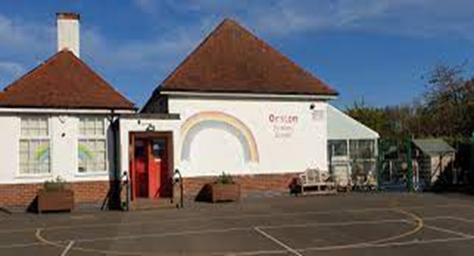


End of Key Stage 2 Assessment - 2026
Orston Primary School

Slide 2

Aims:
To develop an understanding of the requirements of the National Curriculum.
To familiarise parents with assessment arrangements
To understand the different components of the Key Stage 2 Standard Attainment Tests (SATs)
To view some sample materials for the new tests
To understand how you can help your child at home

Slide 3

‘2014’ National Curriculum
Children in all years at Key Stage 1 and 2 are expected to follow the new national curriculum programme of study – including recovering any gaps due to Covid-19.
KS2 SATs and teacher assessment in Year 6 will reflect the curriculum and there are no concessions and alterations as a result of the disruption of 2020-2022.
Their results will go to secondary schools and it does create a target grade for GSCE’s.

Slide 4

Results:
Your child will be assessed as being in one of three key areas:
Woking Below the Expected Standard
Working At the Expected Standard
Working at Greater Depth in the Expected Standard
This is by a scaled score which is determined by the raw score a child gets (correct answers) which is converted to get a scaled score.
You will officially receive this with your child’s scores with their school report.

Slide 5

What are Scaled Scores?
When a pupil sits a test they will receive a raw score (number of correct answers) which will then be converted into a score on the scale.
The scale has a lower point of 80 and an upper point 120.
A scaled score of 80 to 99 = Working Below National Expectations
100-109 = Working At National Expectations
110-120 = Working at Greater Depth in National Expectations
A scaled score of 100 will always represent the ‘national standard’
The raw score that constitutes ‘100’ as a scaled score is worked out using all 600,000 Year 6 pupils scores nationwide.
The scale has a lower point of 80 and an upper point 120.
Past: 80 to 99 = Working Below 100-109 = Working At 110- 120 working at Greater Depth
A child who achieves the ‘national standard’ (a score of 100) will be judged to have demonstrated sufficient knowledge in the areas assessed by the tests.

Slide 6
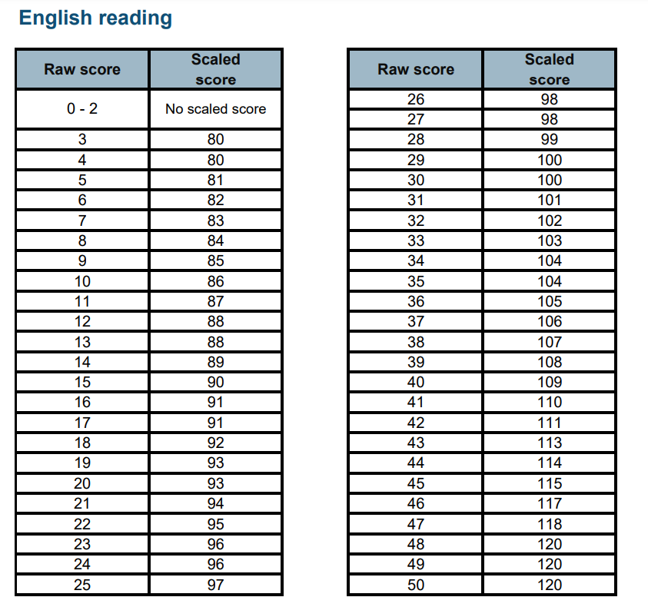
Raw/Scaled Scores example:

Slide 7
For the publication of results, each pupil will receive:
Confirmation of whether or not they attained the national standard.
The school will be informed of the raw score and the scaled score – will report to students.
What do pupils need to get in the tests to score the magic ‘100’?
Last year – 100 – at expected level - raw scores:
Maths – 58/110 (+4) 95/110 = 110 (+2)
Reading – 28/50 (+1) 40/50 = 110 (=)
Spag - 35/70 (-1) 54/70 = 110 (=)
We will prepare pupils thoroughly and encourage pupils to do their best and not be phased by anything they are not sure of.

Slide 8
Orston Results
QA visit from LA (Dec 25) – ‘ Outcomes at the end of KS2 are significantly above national averages on the last 3 year trend. Pupils working at greater depth is considerably above local and national thresholds’.
Exceptionally strong results compared to the rest of the country and to schools in Rushcliffe with similar catchments:

Slide 9
SATs Week 2026:
Key Stage 2 SATs take place nationally in the week commencing 11th May 2026.
Monday 11th May 2026:
- Spelling (approximately 15 minutes)
- Punctuation, Vocabulary and Grammar (45 minutes)
2. Tuesday 12th May 2026:
- Reading (60 minutes)
3. Wednesday 13th May 2026: Mathematics
- Paper 1: Arithmetic (30 minutes)
- Paper 2: Reasoning (40 minutes)
4. Thursday 14th May 2026: Mathematics Paper 3: Reasoning (40 minutes)
All tests are externally marked.

Slide 10
Spelling, Punctuation and Grammar
A Spelling test is administered containing 20 words, lasting approximately 15 minutes. (20 marks)
A separate test (50 marks) is given on Punctuation, Vocabulary and Grammar.
This test lasts for 45 minutes and requires short answer questions, including some multiple choice.
Marks for these two tests are added together to give a total for Spelling, Punctuation and Grammar.

Slide 11
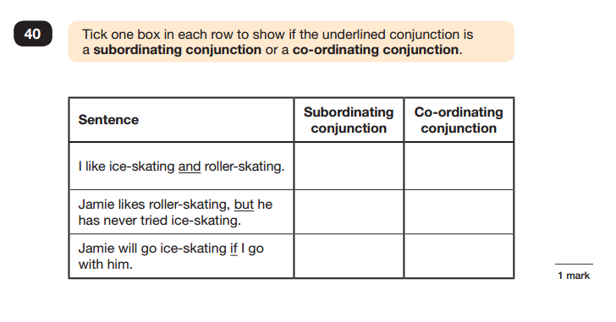
Sample Questions

Slide 12
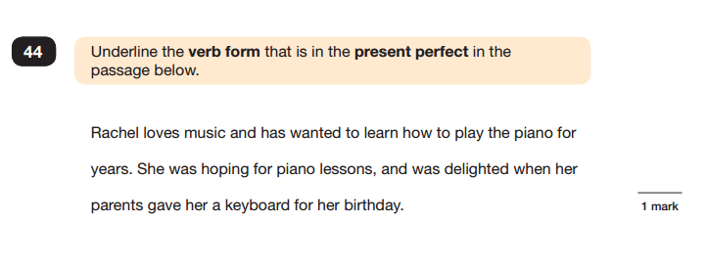
Sample Questions

Slide 13

Reading
The Reading Test consists of a single test paper with three unrelated reading texts.
Children are given 60 minutes in total, which includes reading the texts and answering the questions.
A total of 50 marks are available.
Questions are designed to assess the comprehension and understanding of a child’s reading.
Some questions are multiple choice or selected response, others require short answers and some require an extended response or explanation.

Slide 14
Mathematics
The Mathematics tests – 110 marks available
Children will sit three tests: Paper 1 (40 marks) Paper 2 (35) and Paper 3 (35).
Paper 1 is for ‘Arithmetic’ lasting for 30 minutes, covering calculation methods for all operations, including use of fractions, percentages and decimals.
Papers 2 and 3 cover ‘Problem Solving and Reasoning’, each lasting for 40 minutes.
Pupils will still require calculation skills but will need to answer questions in context.
Questions gradually increase in difficulty. Not all children will be expected to access some of the more difficult questions later in the paper.

Slide 15
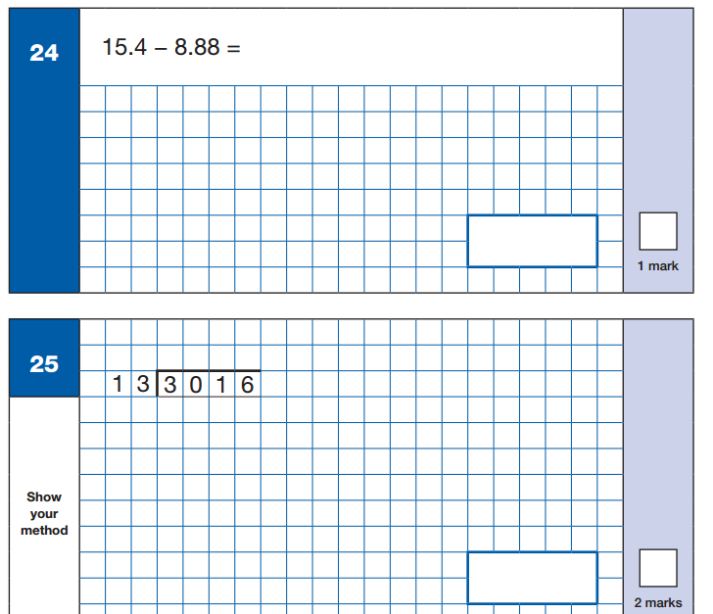
Sample Questions

Slide 16
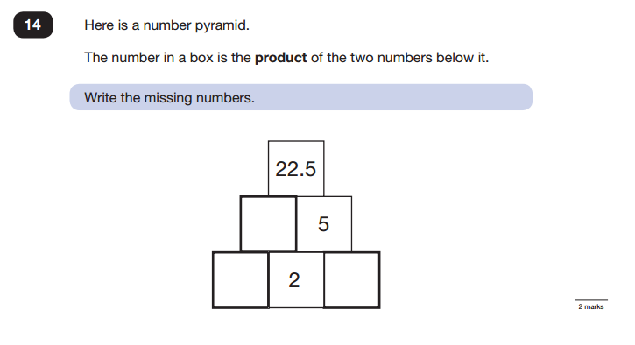
Sample Questions

Slide 17
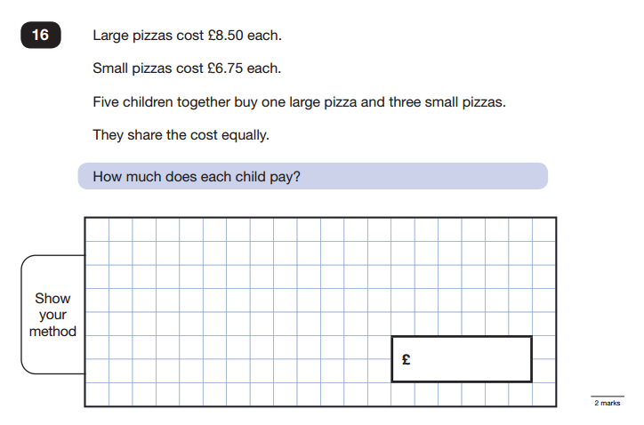
Sample Questions

Slide 18

Writing and Science Teacher Assessment:
Writing and Science will be ‘Teacher Assessed’ before being submitted to Standards and Testing Agency. Pupils complete 5-6 assessed pieces throughout the year
All teacher assessments are based on our continuous assessment throughout the year.
Pupils graded at working towards, working at and working beyond – Have to achieve ALL the criteria

Slide 19
Writing
Pupils will complete a range of work for different purposes - 5-6 assessed pieces throughout the year
Teacher Assessed against criteria – externally moderated by an assessor form LA.
Moderation and judgements clarified through collaboration with other Fosse Four schools and local schools.
Heavy focus on grammar and punctuation
Not a best fit – need all elements for each level

Slide 20
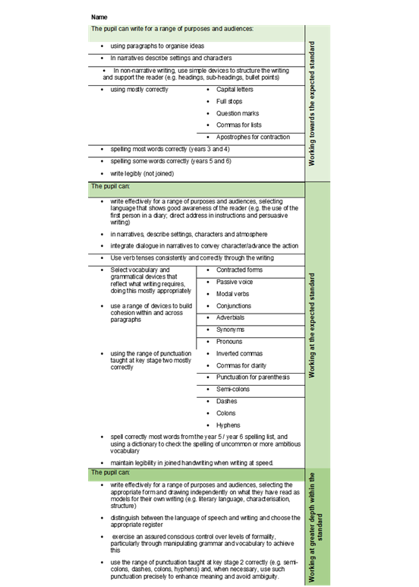
Writing Assessment Grid

Slide 21

How to Help Your Child
First and foremost, support and reassure your child that there is nothing to worry about and they should always just try their best. Praise and encourage!
Ensure your child has the best possible attendance at school – We are moving at great speed to ensure coverage……
Support your child with any homework tasks.
Reading, spelling and arithmetic (e.g. times tables) are always good to practise.
Talk to your child about what they have learnt at school and what book(s) they are reading (the character, the plot, their opinion).

Slide 22
How to Help Your Child with Reading
First and foremost, focus developing an enjoyment and love of reading.
Enjoy stories together – reading stories to your child at KS1 and KS2 is equally as important as listening to your child read.
Read a little at a time but often, rather than rarely but for long periods of time!
Talk about the story before, during and afterwards – discuss plot, characters, their feelings and actions, how it makes you feel etc. Encourage predictions and for your child to have their own opinions – Think why – use evidence from the text to support.
Look up definitions of words together – you could use a dictionary, the internet or an app on a phone or tablet – Vocab = IMP
All reading is valuable!

Slide 23
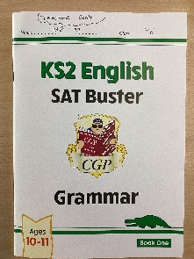
How to Help Your Child with SPaG
Familiarise yourself with the terminology – have a look together – note down anything they are struggling with in their planner.
Practise spellings – crucial.
CGP booklets – KS2 English SAT Buster Grammar
Use terms in the planner and quiz your child on them – can they give an example?
Look up definitions of words together – you could use a dictionary, the internet or an app on a phone or tablet – Vocab = IMP
Ensure SPAG.com homework is completed
Write a sentence – can your child label each word class?

Slide 24
How to Help Your Child with Maths
Play times tables games – Practise all number operations – especially long division and long multiplication.
Arithmetic – CGP good booklets
Play mental maths games including counting in different amounts, forwards and backwards
Encourage opportunities for telling the time
Encourage opportunities for counting coins and money; finding amounts or calculating change when shopping
Identify, weigh or measure quantities and amounts in the kitchen or in recipes
Play games involving numbers or logic, such as dominoes, card games, darts, draughts or chess

Slide 25

Questions?

