Slide 1
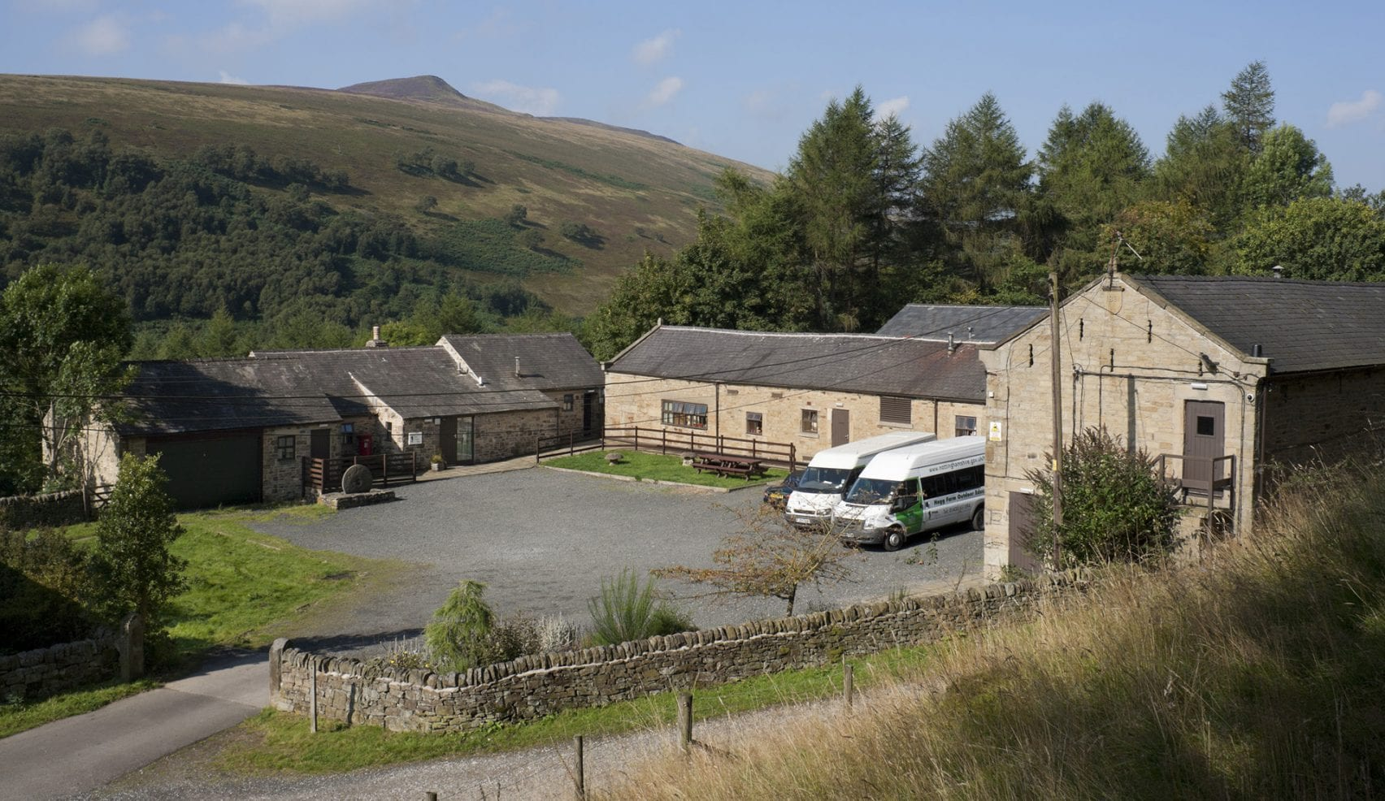



Hagg Farm Y6 Residential
Wednesday 11th March- Friday 13th March 2026

Slide 2

Objectives for the trip
To develop interpersonal skills
To develop independence and responsibility
To build relationships with teachers and other pupils
To build self-esteem through challenge and teamwork
To have fun and create memories!

Slide 3

Children will need:
Old warm clothes they don’t mind getting wet and dirty
£5 spending money in a wallet – children to look after themselves….
Insect repellent - Smidge
Suitcase on wheels or bag to be stored under the bed
See Kit list

Slide 4
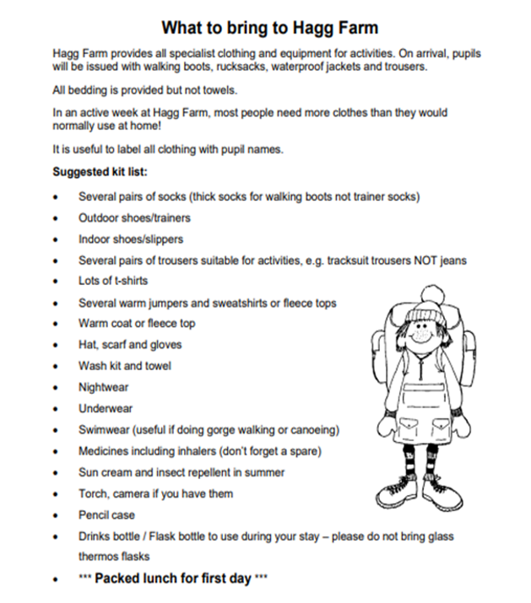

Slide 5

Wednesday 11th March
Children arrive at school by 7:30am and come to school hall with labelled bags/suitcases Any medication please give to myself with a signed medical form in the morning prior to leaving.
Leave for Hagg Farm at 8:15- 8:30am with all bags! An adult will take a car in case of emergencies.
Children must have a packed lunch for Wednesday lunchtime- Please put packed lunch in a disposable carrier bag at the top of small day rucksack with labelled water bottle.
Arrive at the centre by 10am and take bags to the dorms followed by centre induction and kit dissemination
Lunch and then afternoon activities (led by school and centre staff)
Evening Meal
Evening Activities – led by school staff
Bedtime…………….

Slide 6
Thursday 12th March
Early rising
Cooked Breakfast (Ordered night before)
Back to rooms to get ready for morning activities
Morning Activities
Lunch
Back to room to get ready for afternoon activities
Afternoon Activities
Back to room for time to relax and change
Evening Meal -
Evening Activity – led by school staff

Slide 7
Activity Schedule: 3 groups
 | AM | PM
Wednesday | Arrival – 10am and site induction tour and settling in | On site high ropes/climbing (HF instructor), Caving or Rock hopping/bouldering at Higgar Tor (HF instructor) Orienteering/Bushcraft (self-led – School Staff)
Thursday | On site high ropes/climbing (HF instructor), Caving or Rock hopping/bouldering at Higgar Tor (HF instructor) Orienteering/Bushcraft (self-led – School Staff) | On site high ropes/climbing (HF instructor), Caving or Rock hopping/bouldering at Higgar Tor (HF instructor) Orienteering/Bushcraft (self-led – School Staff)
Friday | Local Walk and Hike around the area – led by HF Instructor and school staff | Depart at 1pm

Slide 8
Friday 13th March
Children pack up their things in the morning and vacate the dorm before storing our belongings – We do check to make sure they have left nothing behind!
Breakfast
Morning Activity
Leave at approx 1pm and make our way home…
Arrival back at 3pm – welcome to collect tired and emotional children!
Have a nice relaxing weekend…….with tired and emotional children

Slide 9
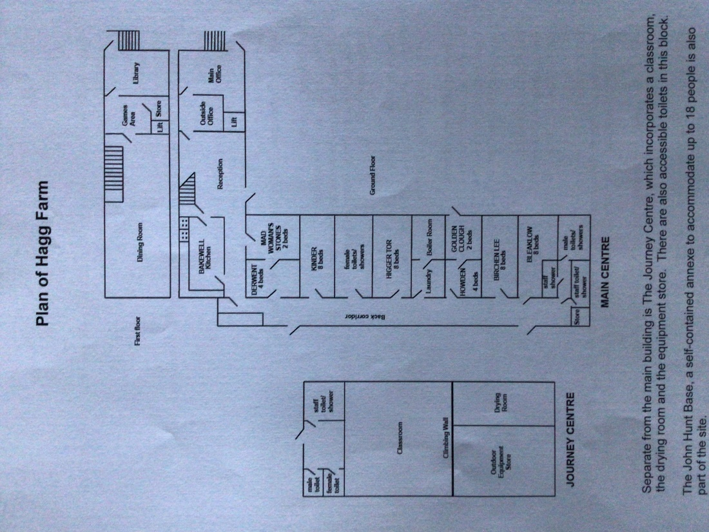

Slide 10
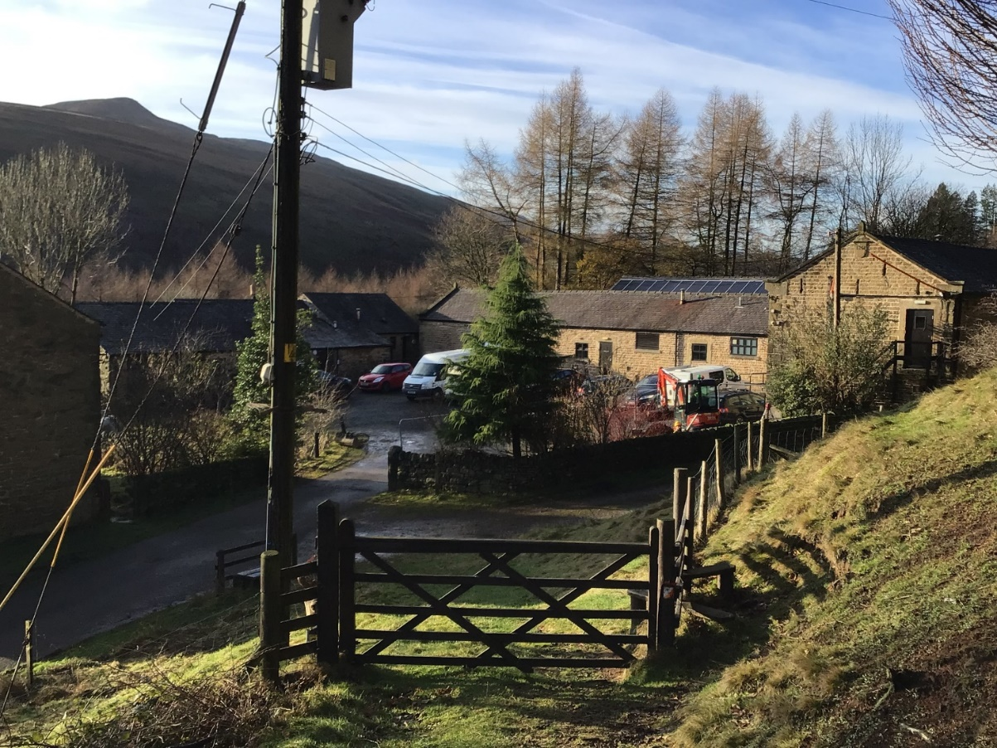
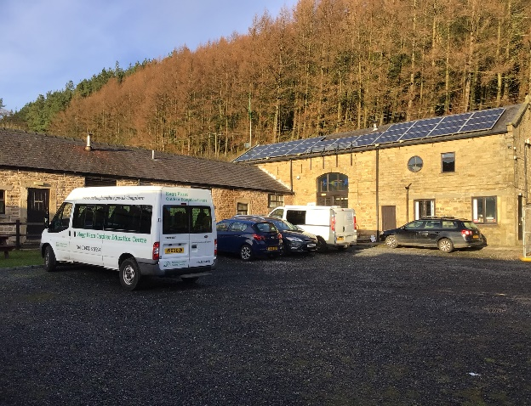
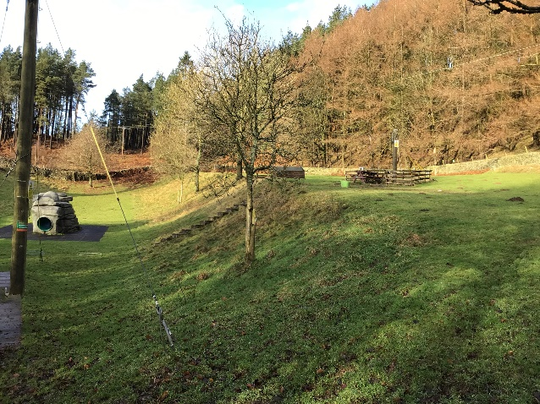
Hagg Farm Photos

Slide 11
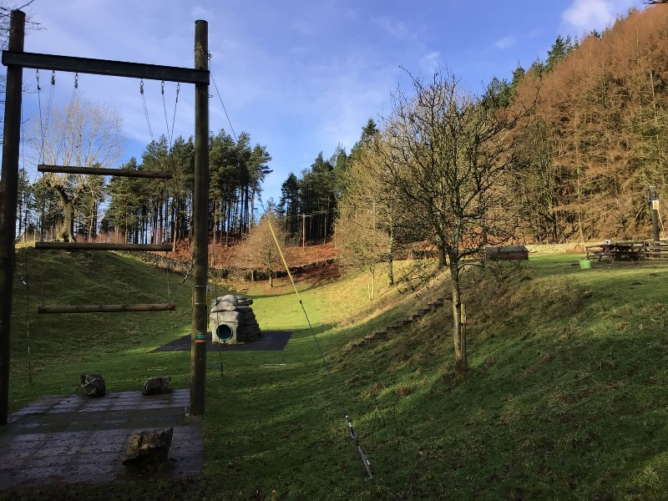
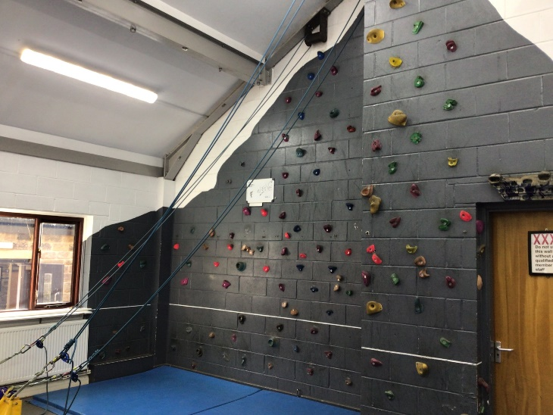
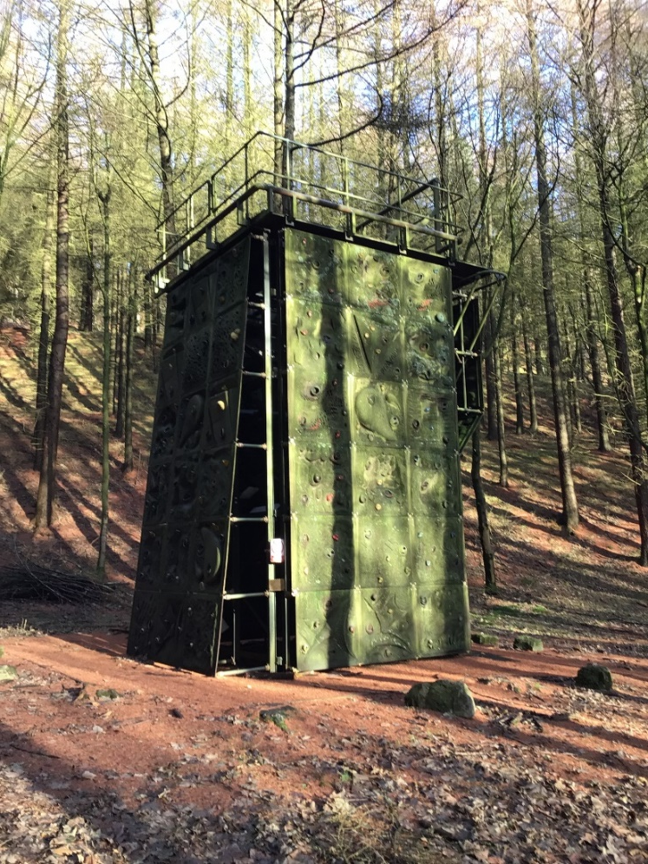
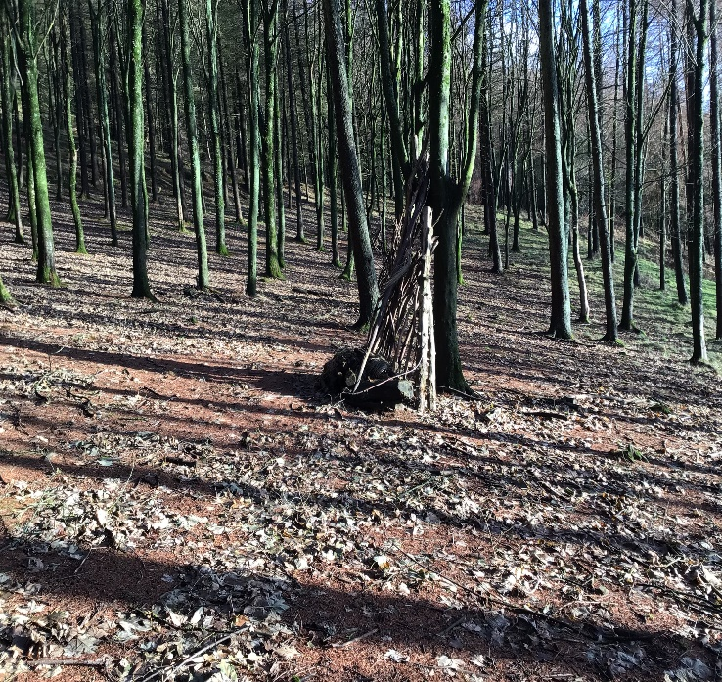
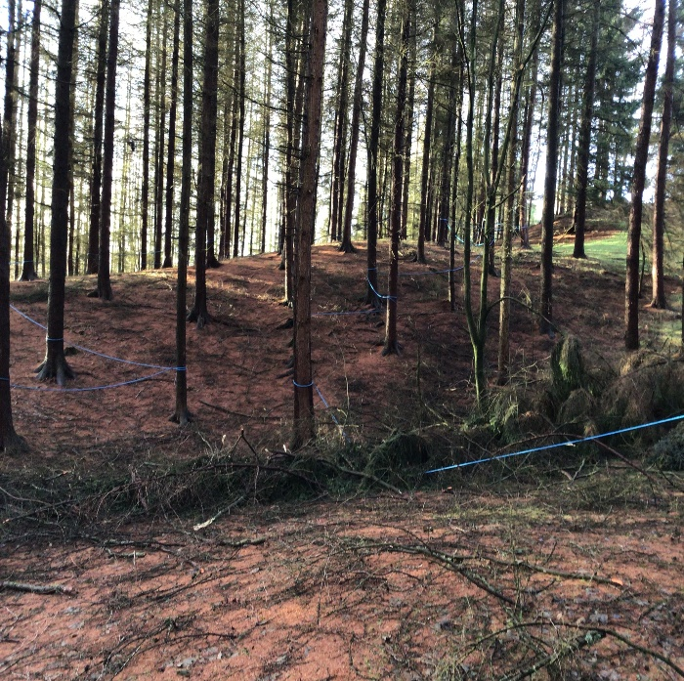

Slide 12
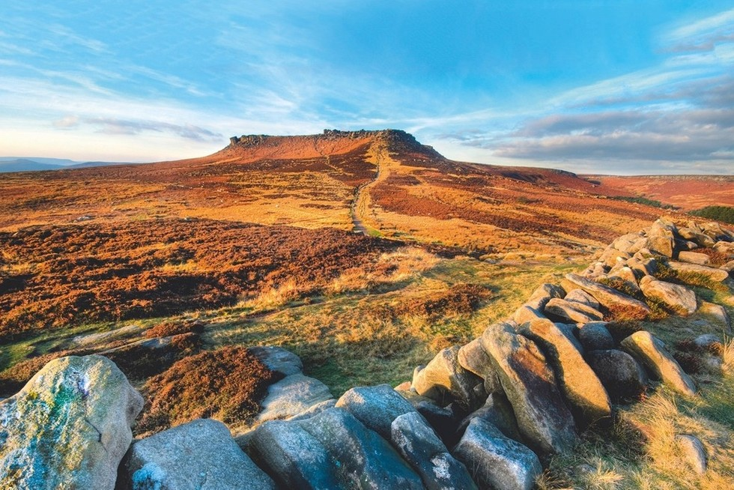
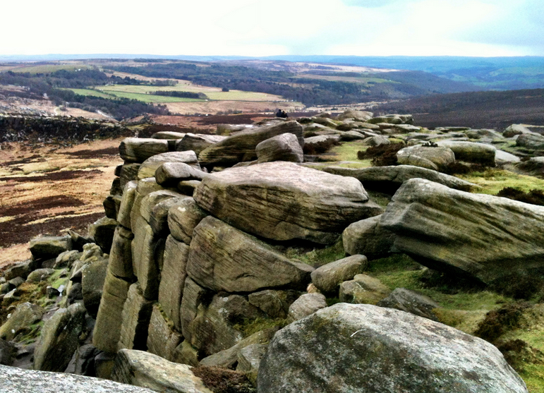
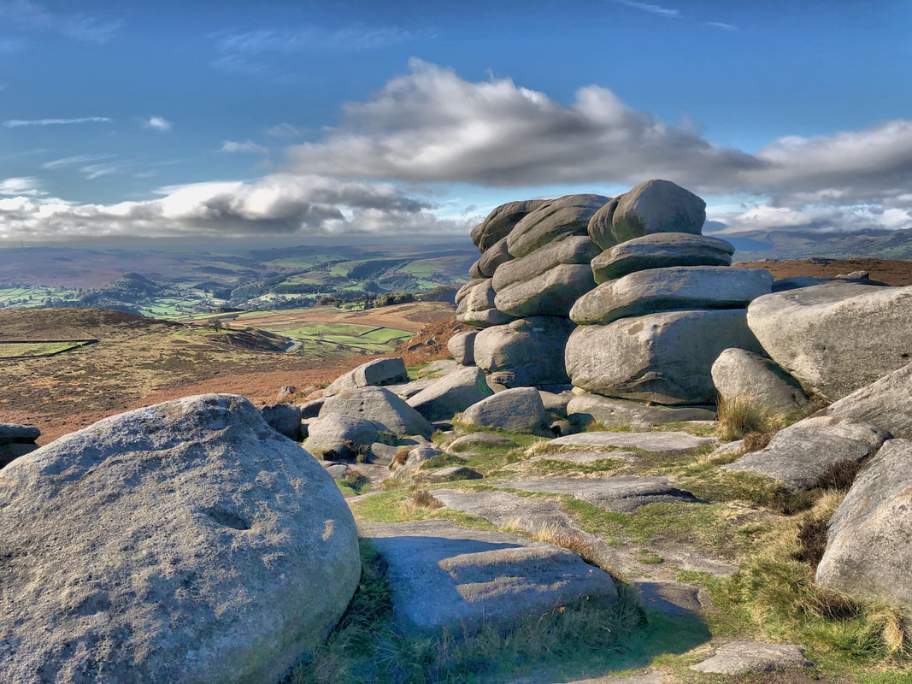

Slide 13
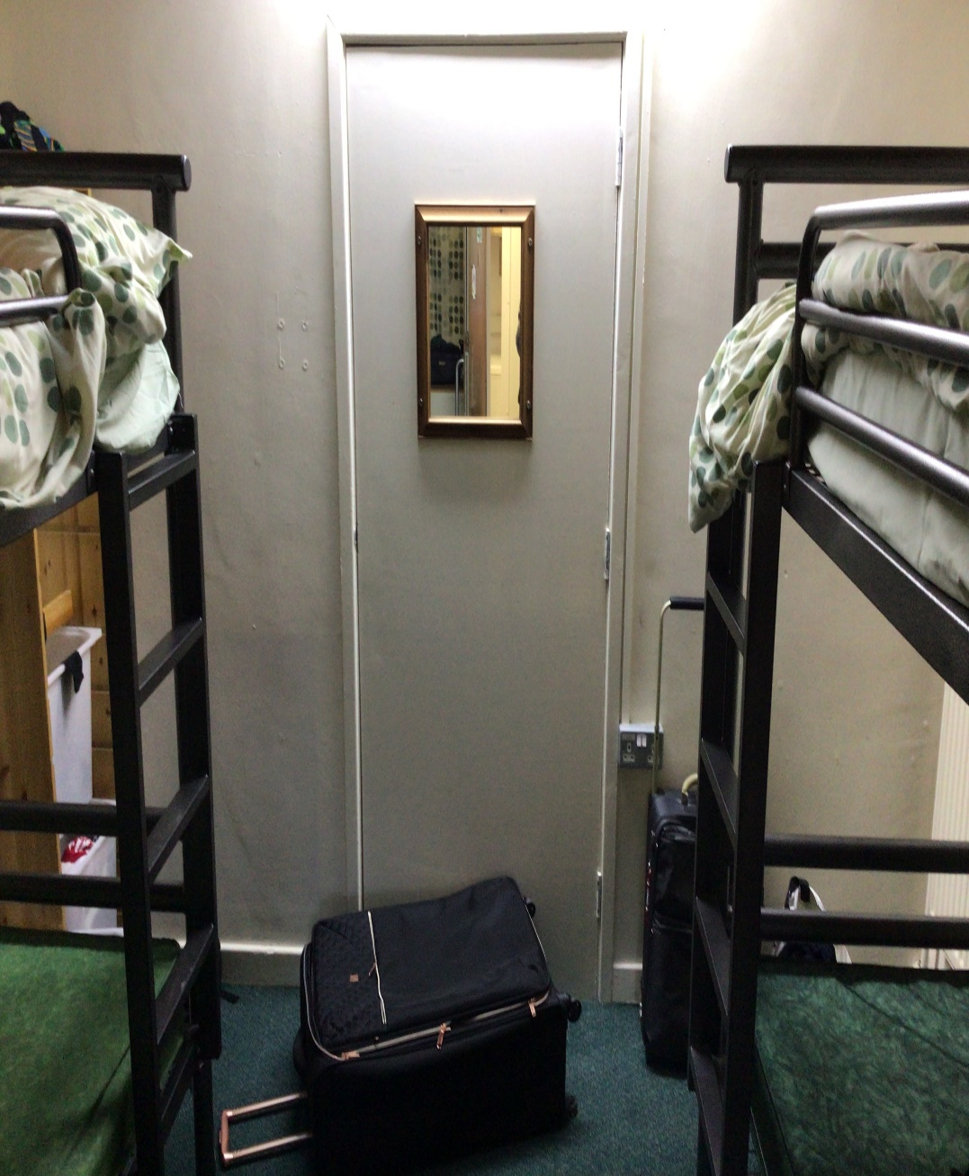
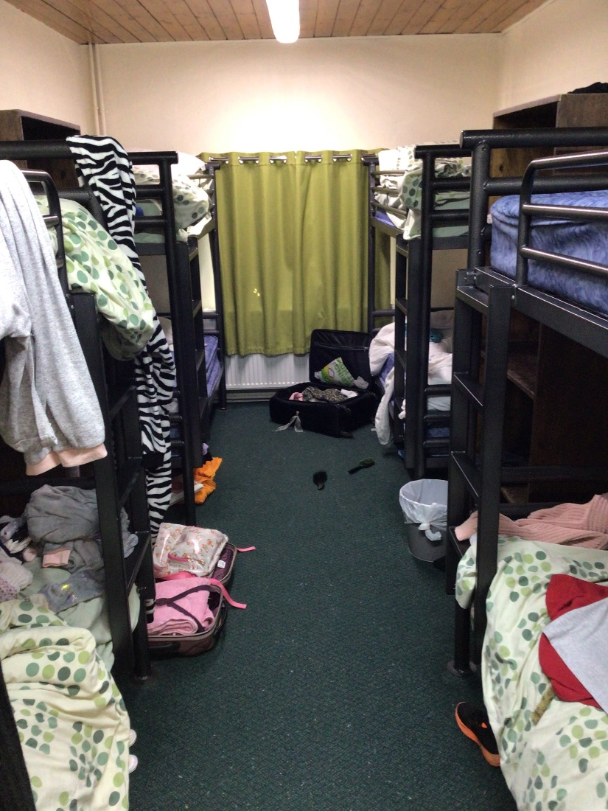
Dorms

Slide 14
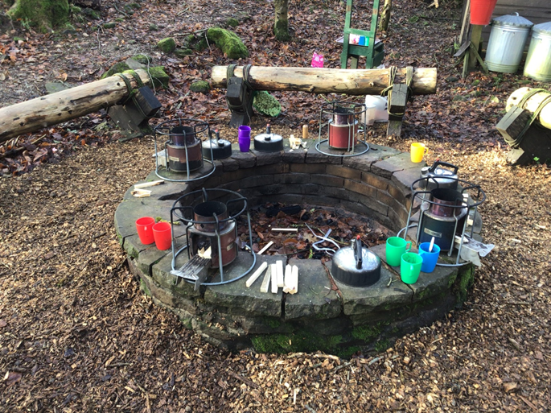
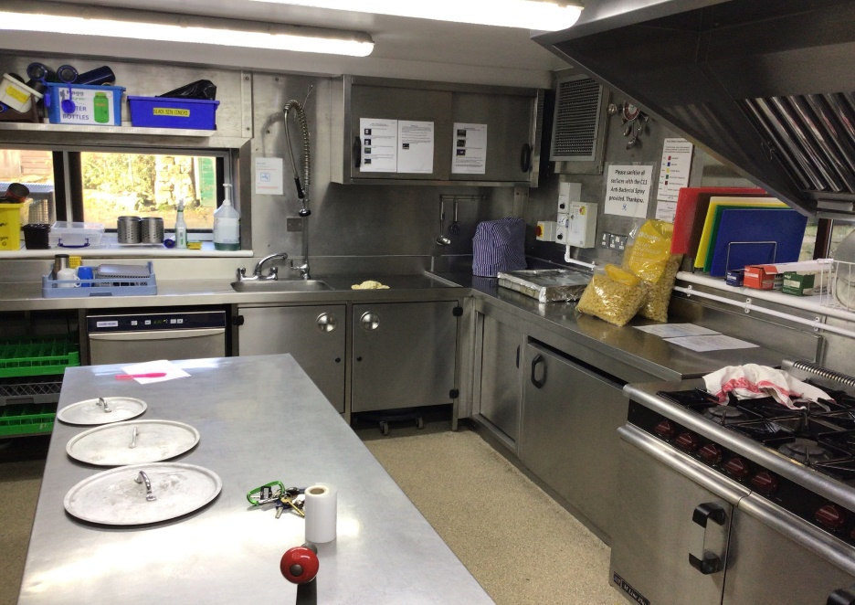
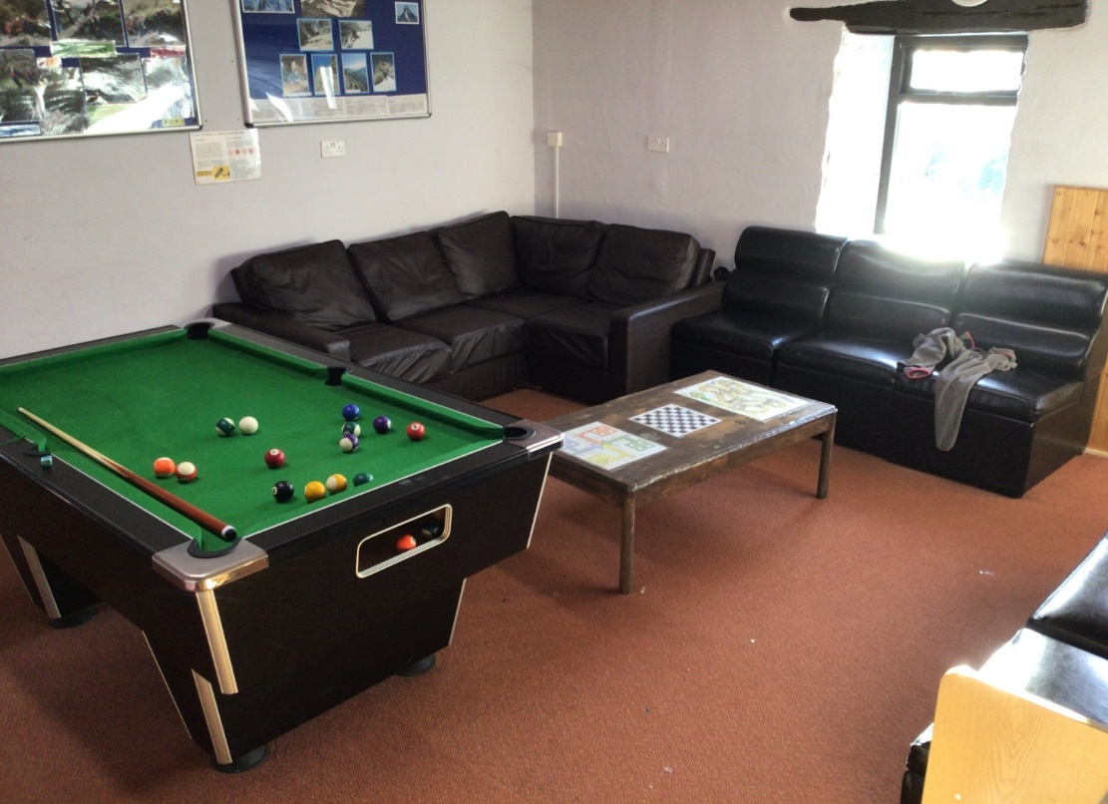
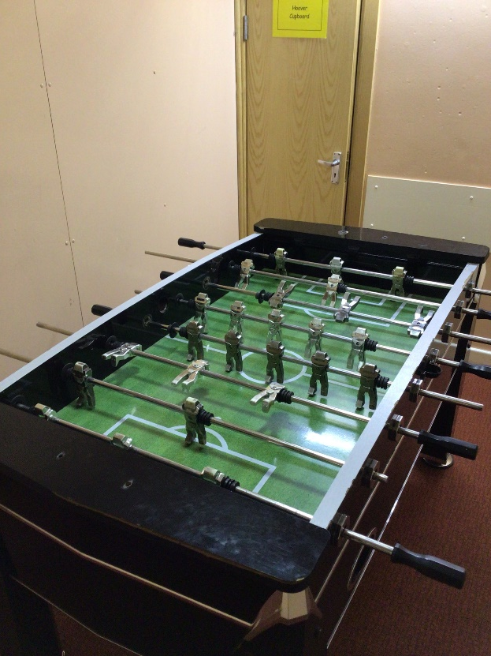

Slide 15
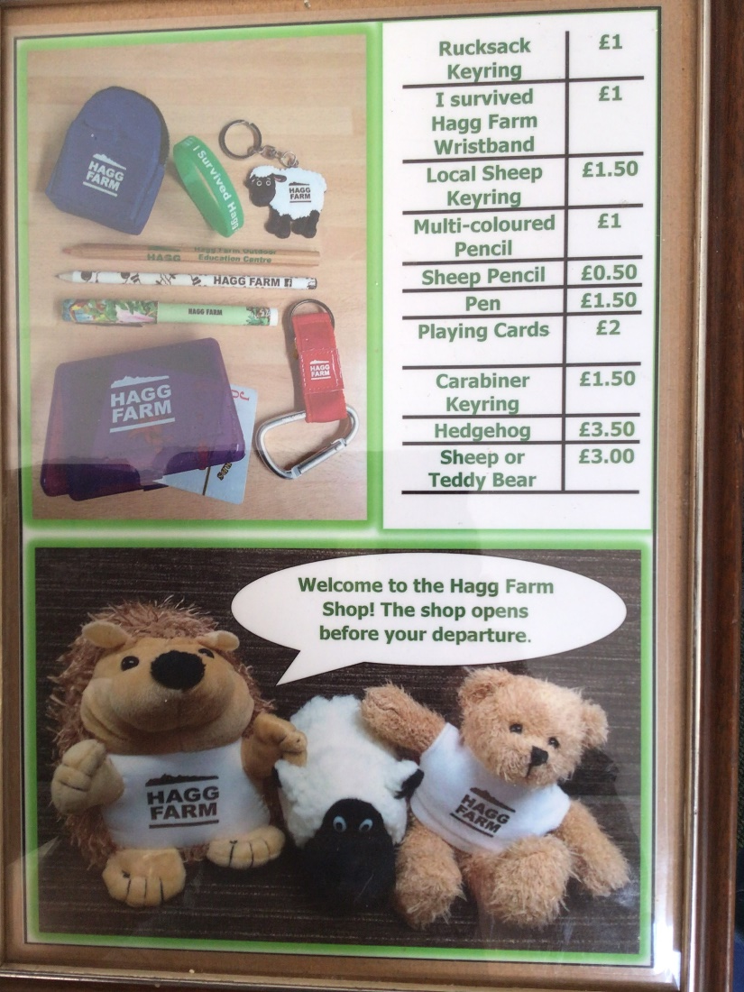

Slide 16
Consent/Medical/other details
Parental consent and medical form - complete the form and return to me - if you have any worries or concerns please let me know or add to the form prior to us travelling.
Dietary requirements- please complete on the above form and we will let the catering staff know.
If medical needs or allergies regarding food please let me know.
Kit List and Shoe size details

Slide 17
Cost and Deposit:
£50 deposit to be paid on Parent Pay by Monday 13th October to secure place.
Once we know how many children – we can finalise the cost.
Cost spread over 2/3 further payments after deposit.
Worked hard to keep the cost as low as possible.

Slide 18
QUESTIONS?

